Slide 1
Week 1 Review
Cindy J. Pang
BIOSTAT 100A Summer Session C 2024
August 9, 2024

Slide 2
Lecture 1: Introduction to Biostatistics
Population vs. Sample
Inference

Slide 3
Lecture 1: Introduction to Biostatistics
Problems Unique to Biostatisticians:
1. Survival Analysis
2. Clinical Trials (see exercise on next slide)
What is our Population?
Who is in our Sample?
3. Survey Sampling (see exercise on next, next slide):
What is our Population?
Who is in our Sample?

Slide 4
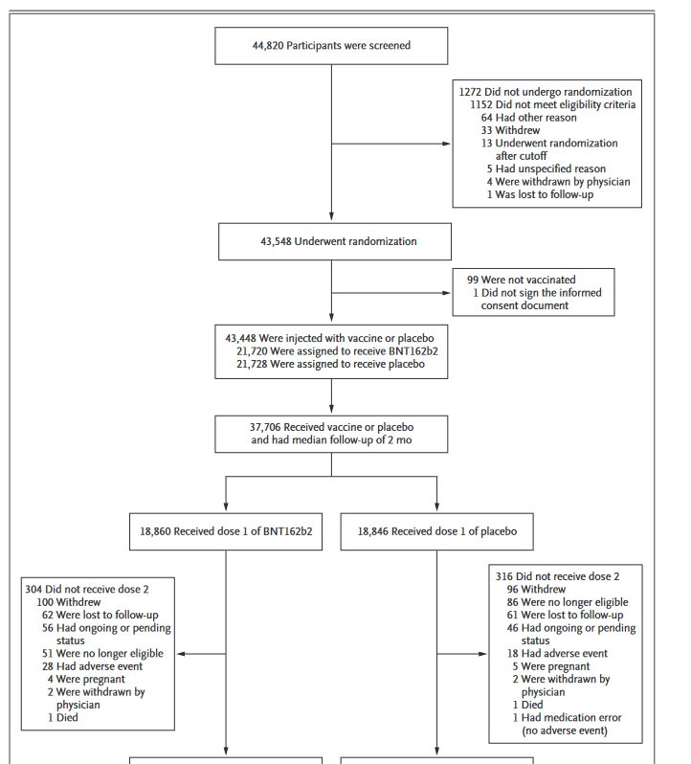
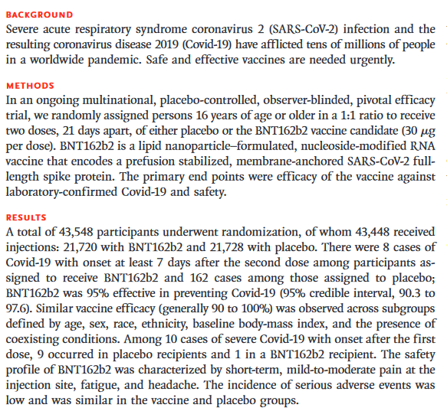
Exercise 1: Clinical Trial
From NEJM: Safety and Efficacy of the BNT162b2 mRNA Covid-19 Vaccine

Slide 5
Exercise 2: Survey Sampling
Table 1. Demographic Analysis Estimates of Net Coverage Error in the 2020 Census for the Population Ages 0 to 4 by State
State FIPS Code | State Name | DA Population Estimate | 2020 Census Count | Net Coverage Error Estimate
01 | Alabama | 297,751 | 286,529 | -3.77
02 | Alaska | 50,255 | 48,104 | -4.28
04 | Arizona | 419,488 | 392,370 | -6.46
05 | Arkansas | 189,309 | 179,575 | -5.14
06 | California | 2,319,173 | 2,137,439 | -7.84
08 | Colorado | 325,309 | 314,580 | -3.30
09 | Connecticut | 181,819 | 176,831 | -2.74
10 | Delaware | 54,992 | 51,230 | -6.84
11 | District of Columbia | 44,083 | 37,095 | -15.85
12 | Florida | 1,143,120 | 1,030,284 | -9.87
13 | Georgia | 651,900 | 614,218 | -5.78
15 | Hawaii | 85,659 | 77,352 | -9.70
16 | Idaho | 114,638 | 114,128 | -0.44
17 | Illinois | 738,282 | 705,616 | -4.42
18 | Indiana | 420,162 | 408,828 | -2.70
19 | Iowa | 195,743 | 190,064 | -2.90
20 | Kansas | 185,068 | 179,446 | -3.04
21 | Kentucky | 274,385 | 264,254 | -3.69
The U.S. Census
https://www.census.gov/data/tables/2020/demo/popest/2020-state-county-da-tables.html

Slide 6
Lecture 2: Types of Data
Data Taxonomy
Qualitative
Continuous
Discrete
Quantitative

Slide 7
Lecture 2: Types of Data
Stevens’ Scale of Data Classification
 | Categorical | Order | Add/Subtract | Mult./Divide | Examples
Nominal
Ordinal
Interval
Ratio

Slide 8
Lecture 3: Introduction to Sampling
Rationale:
Types of Samples:
Probability (Random) Sampling
Non-Probability Sampling (know examples of non-probability samples)

Slide 9
 | When/Why do this type of sampling | How to conduct this type of sampling | How to select participants | Examples
Simple Random Sampling (SRS)
Stratified Random Sampling
Cluster Random Sampling
Systematic Random Sampling

